Slide 1

Smart MIS for Research and Educational Organizations

Slide 2
Submitted By
S.M. Shahriyar ( BSSE 1044)
Supervised By
Sumon Ahmed
Associate Professor
Institute of Information Technology

Slide 3

Project Stakeholder
Abu Kowser
Senior Scientific Officer,
SSO, IFRD, BCSIR

Slide 4
Presentation Outline
Introduction
Tools and Technologies
Background
Limitations
Project Objective
About the Project
Future work

Slide 5

Introduction
Here all the information of that organization will be stored.
It helps the organization concerned person to find and process the information in a short time.

Slide 6

Background
Researchers spends a lot of time in administrative work like have to send their scientific work in different places with different information.
Most university teachers don’t send their scientific work to the university administration because of their heavy work pressure, which impact on university world ranking.

Slide 7

Want to arrange a training program ?
Background
কারা এটার জন্য যোগ্য
কে কে অগ্রাধিকার পাবে
আগে কে কে ট্রেনিং নিয়েছে

Slide 8
Want to know the progress of your organization in scientific work ?
Background
সব তথ্য পাচ্ছি তো
তথ্য সঠিক তো
সবাই তথ্য দিচ্ছে তো
কোথায় পাবো

Slide 9

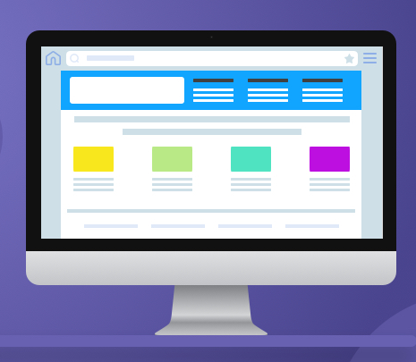
Here is the Solution for you -
Background
Intelligent MIS

Slide 10
Who will use it ?
Motivation
Application main Stakeholder is Bangladesh Council of Scientific and Industrial Research ( BCSIR )
But any educational institution like DHAKA UNIVERSITY also use the different module of it.

Slide 11


Project Objective
Using PMIS user easily add and manipulate his/her information.
Automated Scientific paper searching tool will find the scientific papers for the user.
https://depositphotos.com/430460192/stock-illustration-sign-page-abstract-concept-vector.html
Reduce the time, cost, visit and improve the overall performance of an organization.
Reduce almost 75% working hour of the employee for data collection, sorting, and management for different work purpose.
https://www.bwslaw.com/publications/a-district-cannot-unilaterally-reduce-work-hours-or-work-year-without-negotiating-the-reduction/

Slide 12
QUALITY FUNCTION DEPLOYMENT
Normal Requirements
User has unique identity that is, user can login to the system
User can add his/her personal and official details using PIMS
The system will integrate with 4 different MIS system

Slide 13
QUALITY FUNCTION DEPLOYMENT
Expected Requirements
Exciting Requirements
Overall operational correctness and reliability
Interactive User Interface.
Show scientific paper to the user or organization concerned person.

Slide 14





Tools and Technologies
Language
Framework
IDE
Version Controlling
https://www.pngwing.com/en/search?q=django, https://seeklogo.com/vector-logo/323431/visual-studio-code, https://commons.wikimedia.org/wiki/File:Octicons-mark-github.svg,

Slide 15
Limitations
Initially we are only used google scholar account for scientific paper searching
We used a free proxy router with limited api request credits .
Initially we only used email and name as parameter for scientific paper searching

Slide 16
About Intelligent MIS
Some Snapshots of this Intelligent MIS

Slide 17
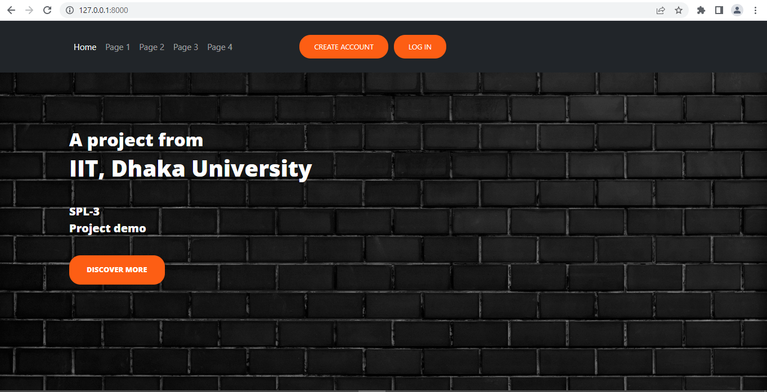
About Intelligent MIS

Slide 18
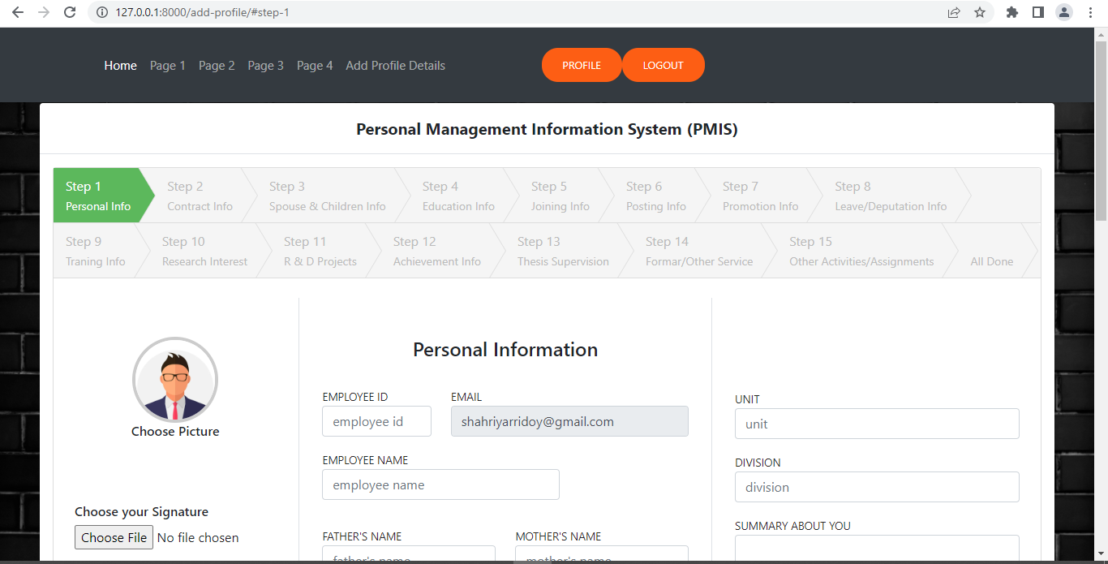
About Intelligent MIS

Slide 19
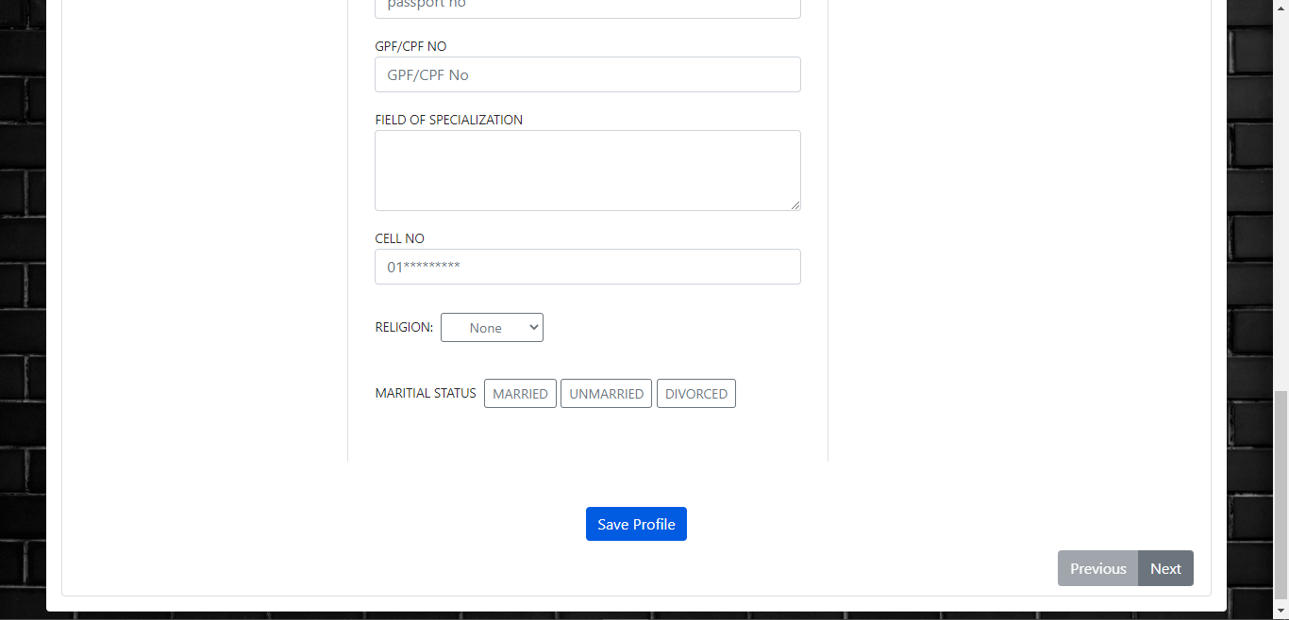
About Intelligent MIS

Slide 20
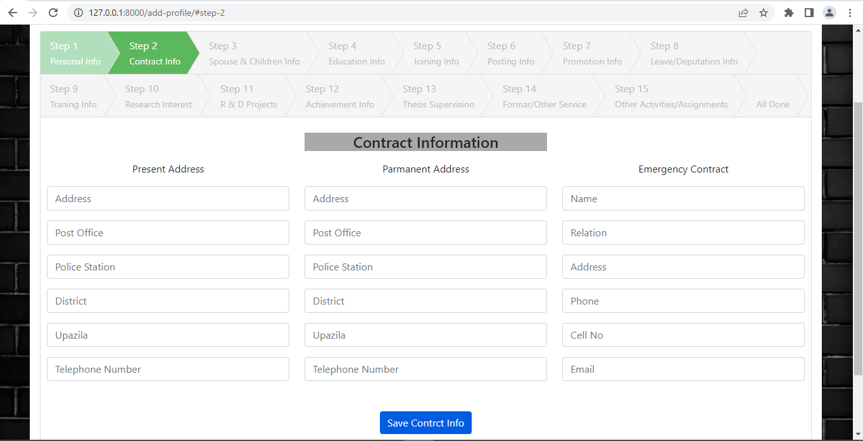
About Intelligent MIS

Slide 21
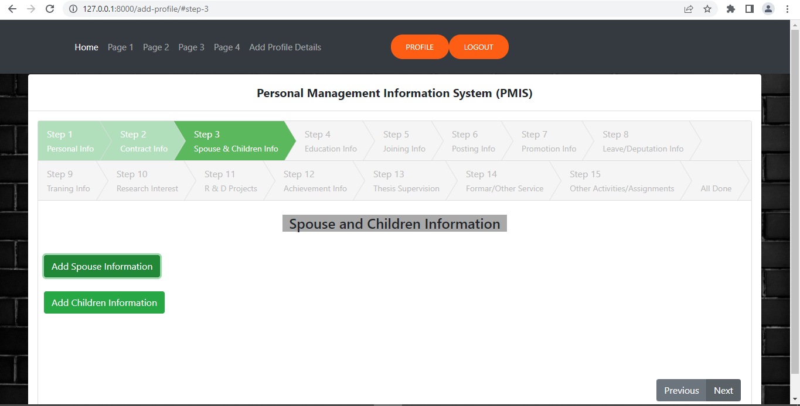
About Intelligent MIS

Slide 22
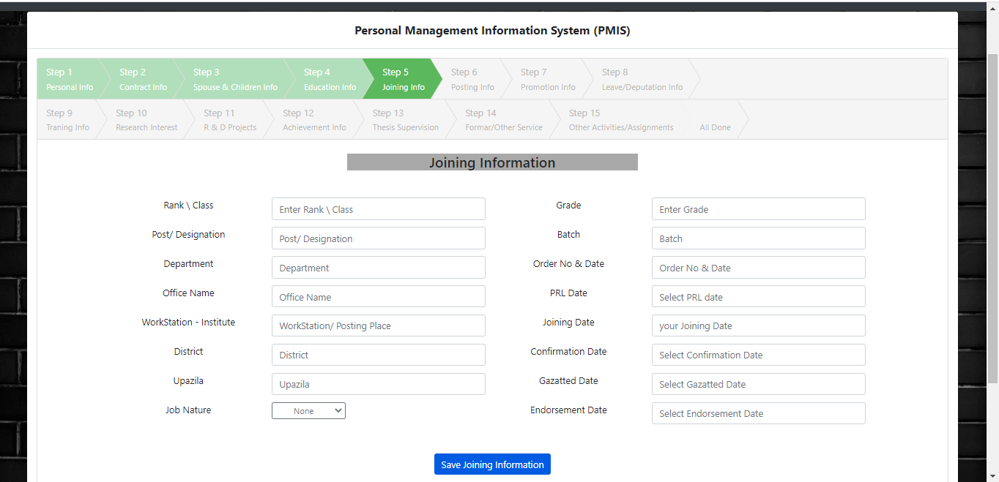
About Intelligent MIS

Slide 23
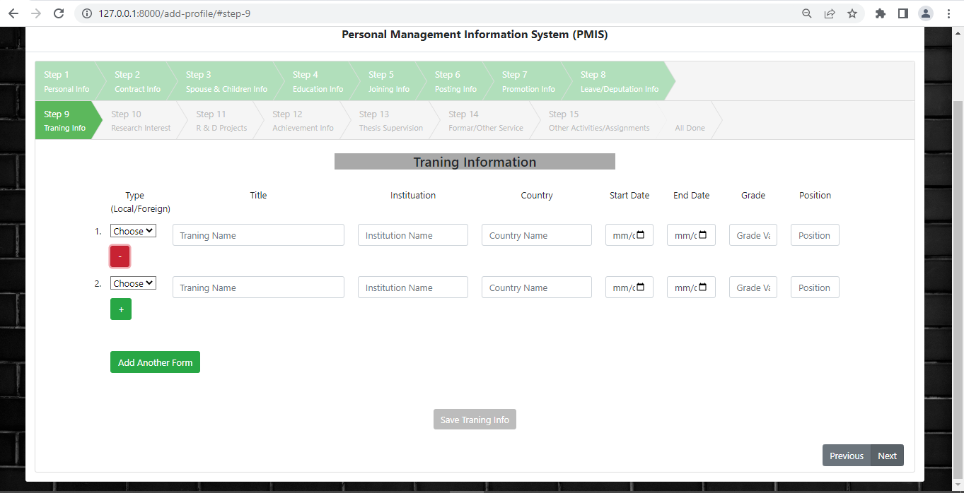
About Intelligent MIS

Slide 24
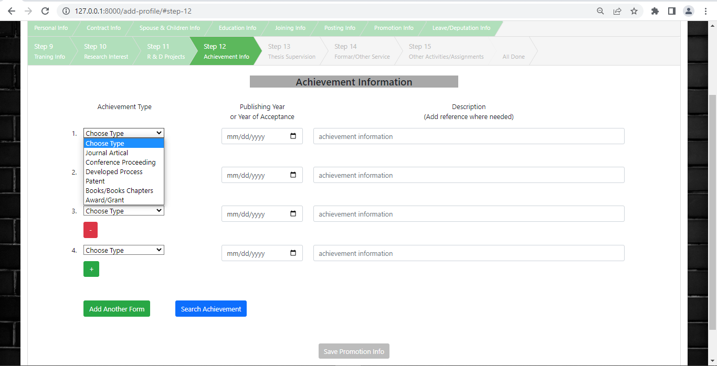
About Intelligent MIS

Slide 25
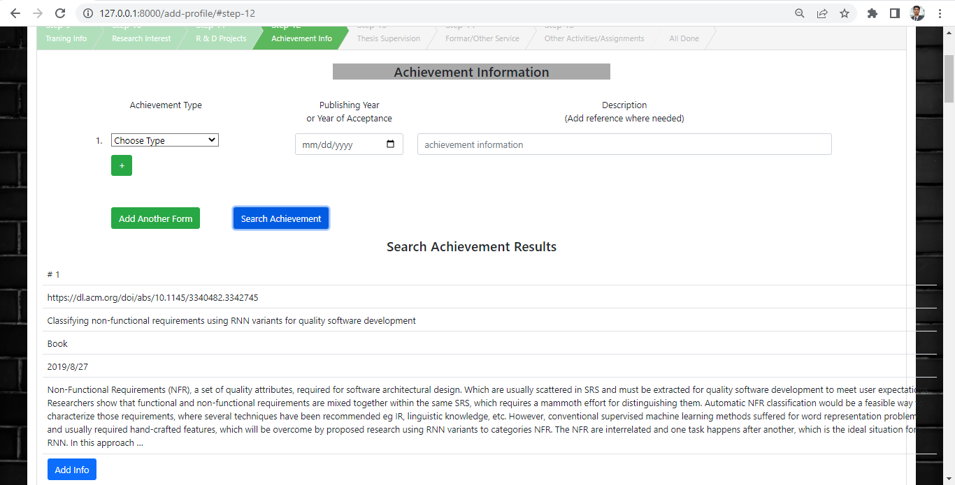
About Intelligent MIS

Slide 26
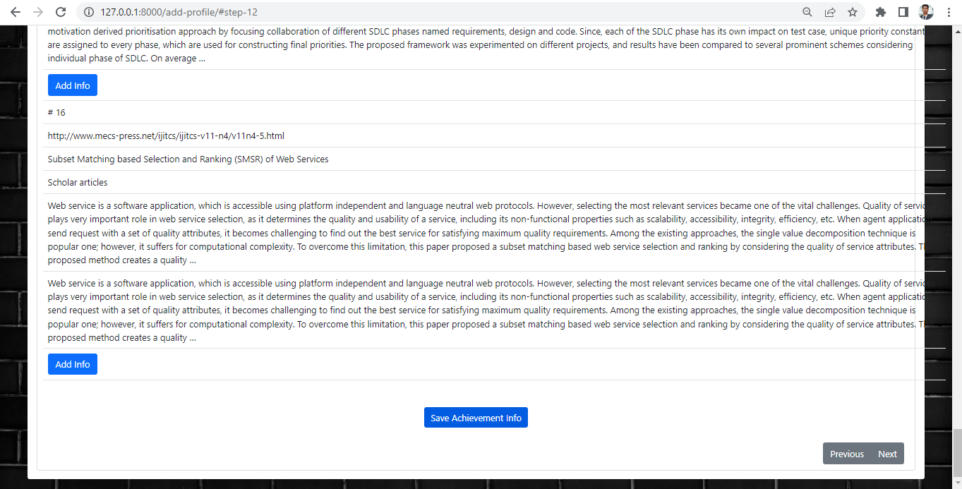
About Intelligent MIS

Slide 27
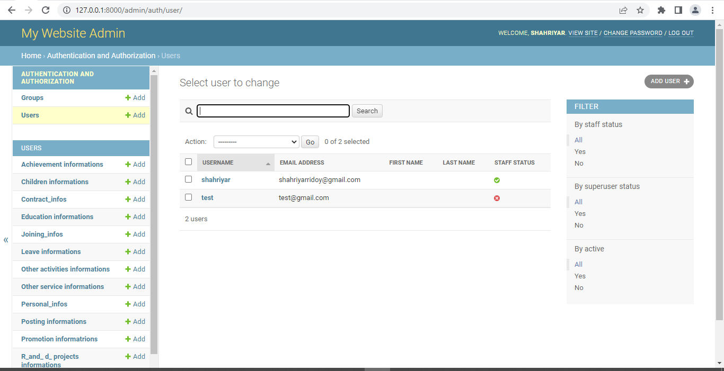
About Intelligent MIS

Slide 28

Future Work
Find the best Machine Learning approach for getting the best search result.
Using Machine Learning, cluster the collected Scientific papers information based on research fields
https://velocityglobal.com/blog/forget-machine-learning-humans-still-a-lot-to-learn-about-themselves-ii/

Slide 29
Future Work
Hypothesis Model for Searching AI-
Searching paper using different parameter with combinations
Collect the results data and find the accuracy of searches result
Gather search result and make a dataset
Auto search with specific parameters for best result outcome
Train the dataset
using Machine Learning
Reinforcement Learning process

Slide 30
THANKS!
Any questions?

Slide 31
Challenges
Implementing django dynamic formset.
Finding alternative solution for proxy router.
Scraping the scientific paper search data properly.
Make the forms dynamic for user.

Slide 32
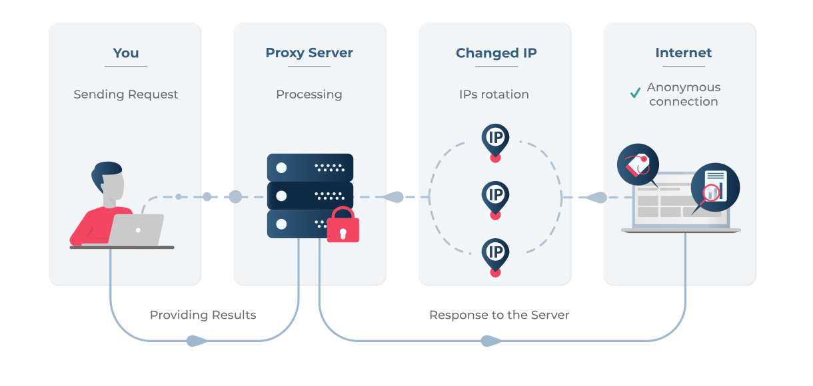
Challenges
https://proxyscrape.com/blog/the-complete-guide-to-proxies-for-web-scraping

Slide 33
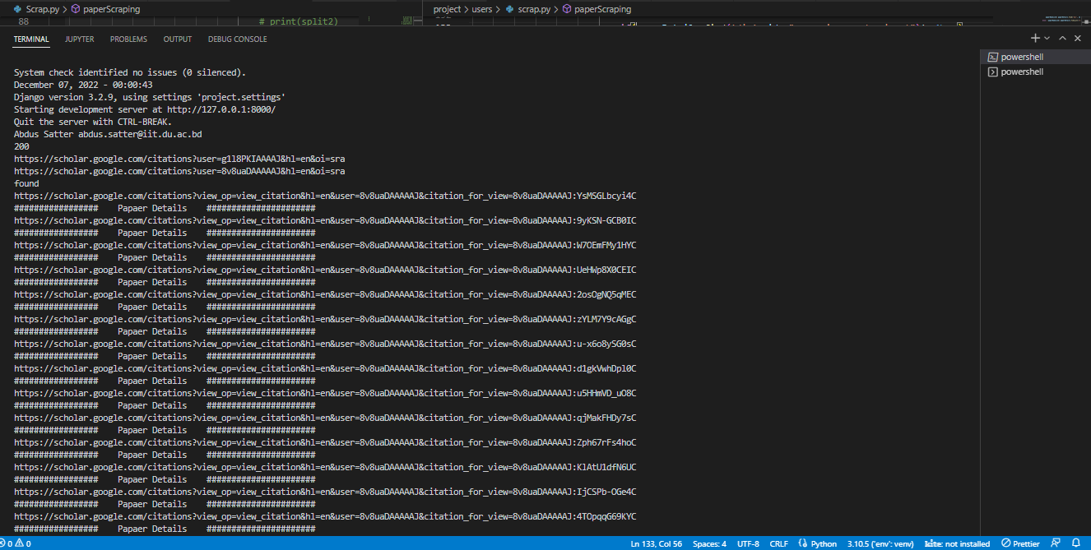
Snapshots

Slide 34
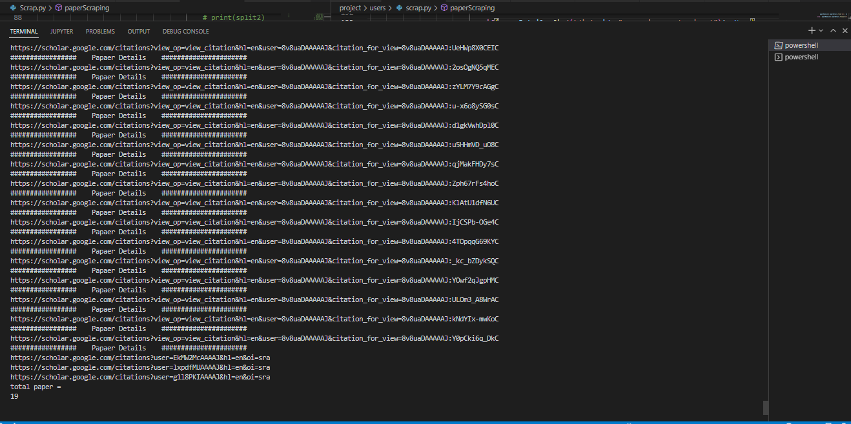
Snapshots

